Slide 1
Studio Orchestra
Database 3 Assignment

Slide 2
Ticketing Systems The payment system for soloists

Slide 3
Ticketing Systems The payment system for soloists

Slide 4
Administrator arranges a concert with a venue Customers can purchase tickets easily

Slide 5
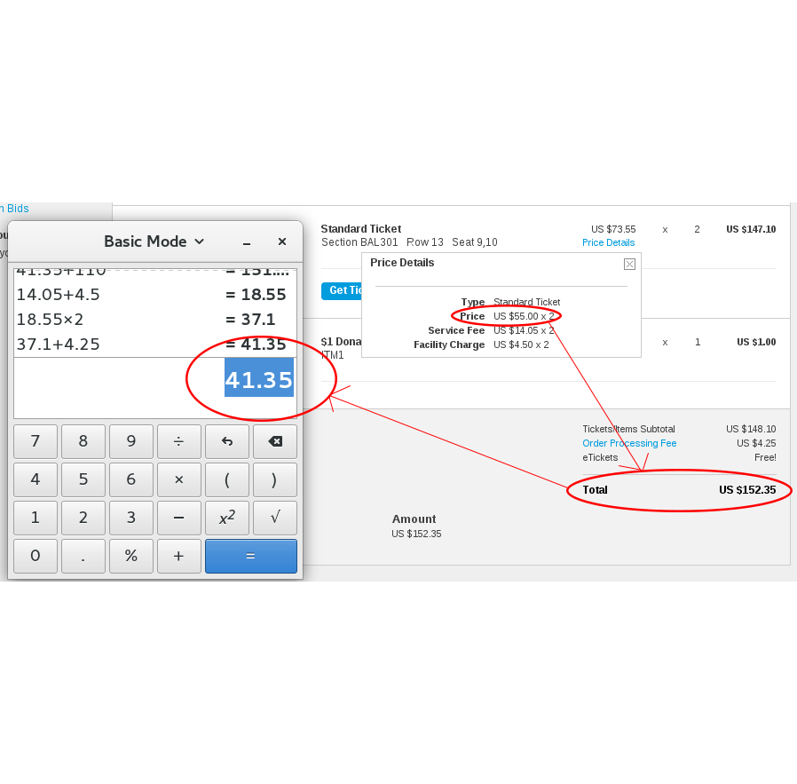
TicketMaster

Slide 6
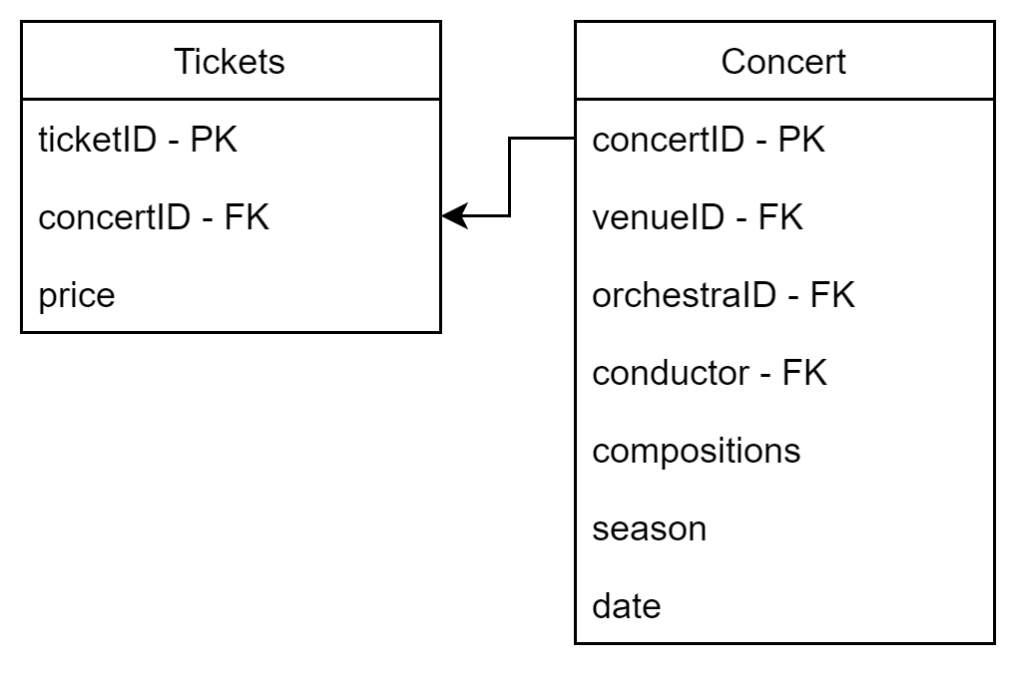

Slide 7
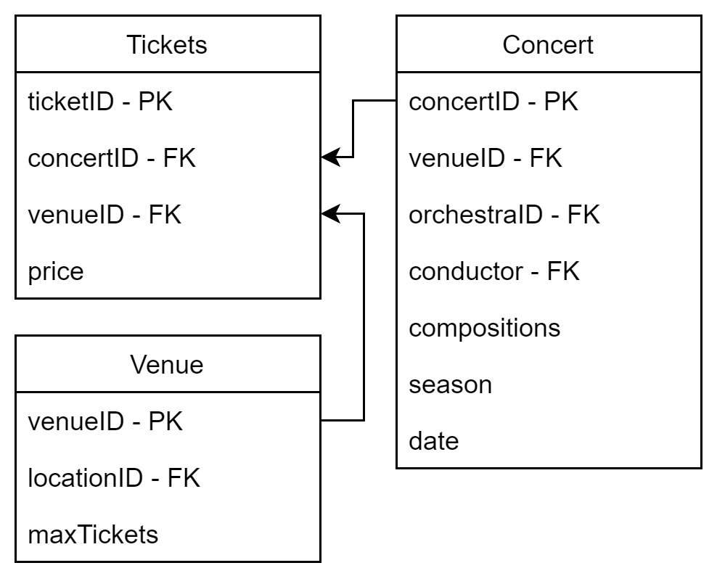

Slide 8
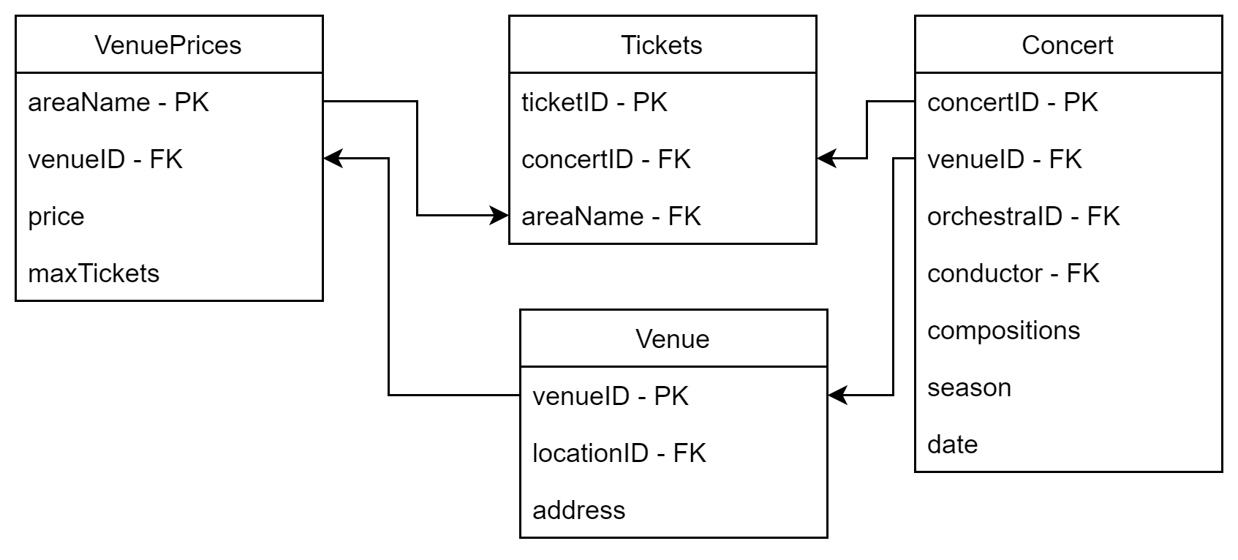

Slide 9
Ticketing Systems The payment system for soloists

Slide 10
Administrator assigns musicians as soloists Musicians are paid the correct amount

Slide 11
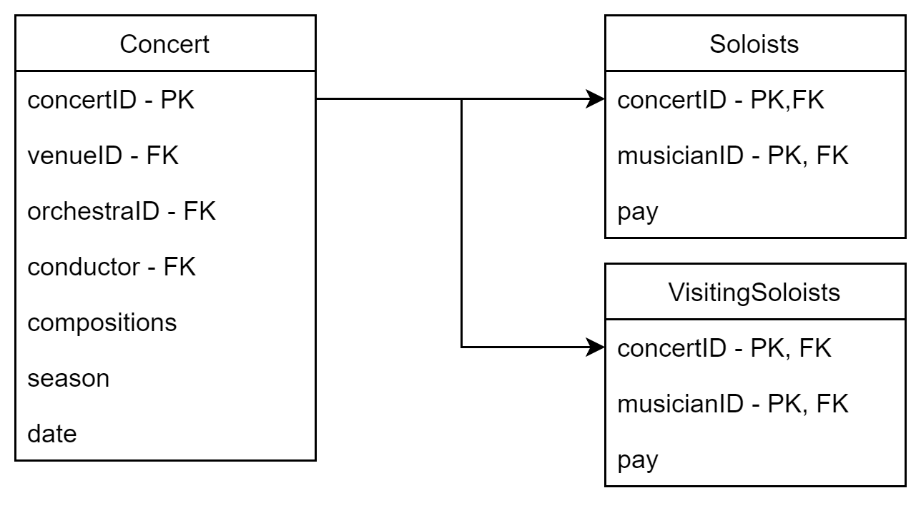

Slide 12
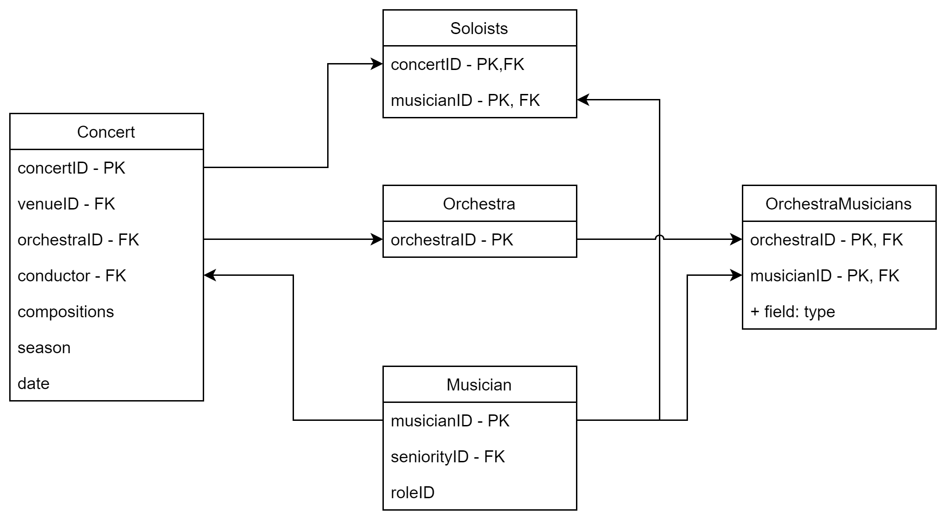

Slide 13
SQL VIEW
SELECT musicianID
FROM Soloists
WHERE concertID = 151
AND [NOT] EXISTS (
SELECT musicianID
FROM Concerts
JOIN Orchestra ON Concerts.orchestraID = Orchestra.orchestraID
JOIN OrchestraMusicians
ON Orchestra.orchestraID = OrchestraMusicians.orchestraID
WHERE concertID = 151
)

